Slide 1
Automation Project Justdial website
Presented by: Bhuvani Kaveri
Guided by:Amruta deore

Slide 2
Introduction
JustDial is an Indian internet technology company that provides local search for different services in India over the phone, website and mobile apps.
This Project aims to do overall testing like functional testing, GUI testing on Justdial website to check quality of application using selenium web driver. It helps to improve quality of website and saves time for manually doing this testing.
In this project our main focus is to test the Books Module and Modular Kitchen module.

Slide 3
Software Requirements:
Operating System: Windows 11
Browser: Latest version of Google Chrome
Platform: Eclipse Oxygen 2017
Automation Tool and Language: Selenium WebDriver, Java
Files: JDK, Selenium Jar files, Common IO file

Slide 4
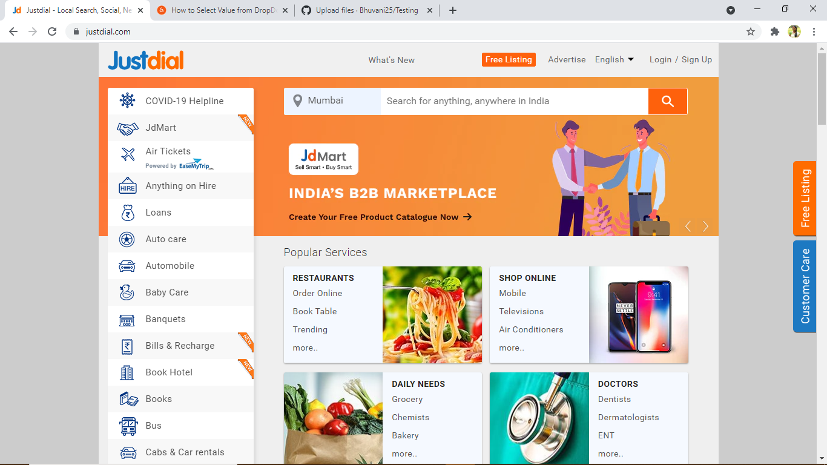
JUSTDIAL-Launch Homepage
WebDriver driver = new ChromeDriver();
driver.manage().window().maximize();
driver.get("https://www.justdial.com/");
System.out.println("Navigated to the application");

Slide 5

To verify the functionality of Justdial website logo
driver.findElement(By.xpath("//header/section[1]/div[1]/div[1]/span[1]/a[1]/img[1]")).click();
System.out.println("We are at Justdial's homepage");

Slide 6
To verify and display the URL of Current page of browser. driver.getCurrentUrl(); System.out.println("Current URL IS:"+driver.getCurrentUrl());
To verify and display the title of the current page.
driver.getTitle();
System.Out.Println(“Title of page is:" + driver.getTitle());

Slide 7
To verify the functionality of Scrolldown JavascriptExecutor js = (JavascriptExecutor) driver; js.executeScript("window.scrollBy(0,1000)"); System.out.println("Scroll down"); Thread.sleep(2000);
To verify the functionality of scroll up
js.executescript("window.scrollBy(0,-1000)");
System.out.println("scroll up");

Slide 8
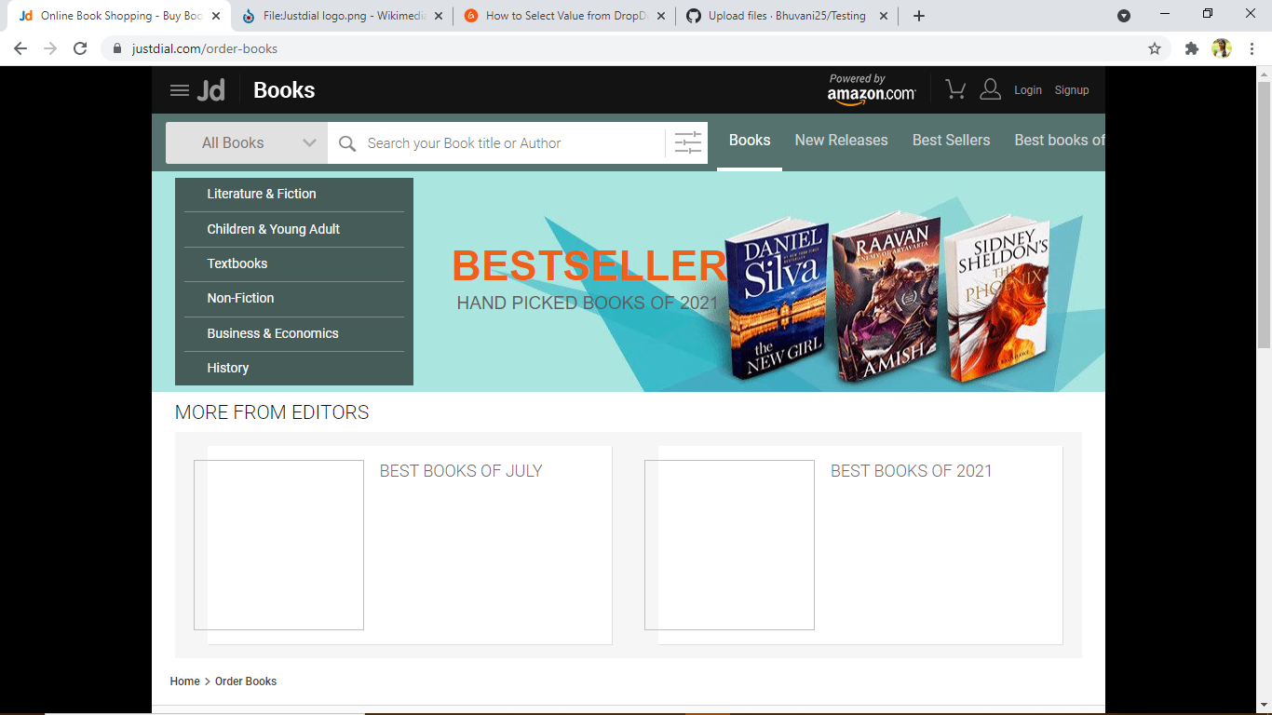
Navigating to first module:Book module
WebElement book=driver.findElement(By.id("hotkeys_text_11"));
book.click();

Slide 9
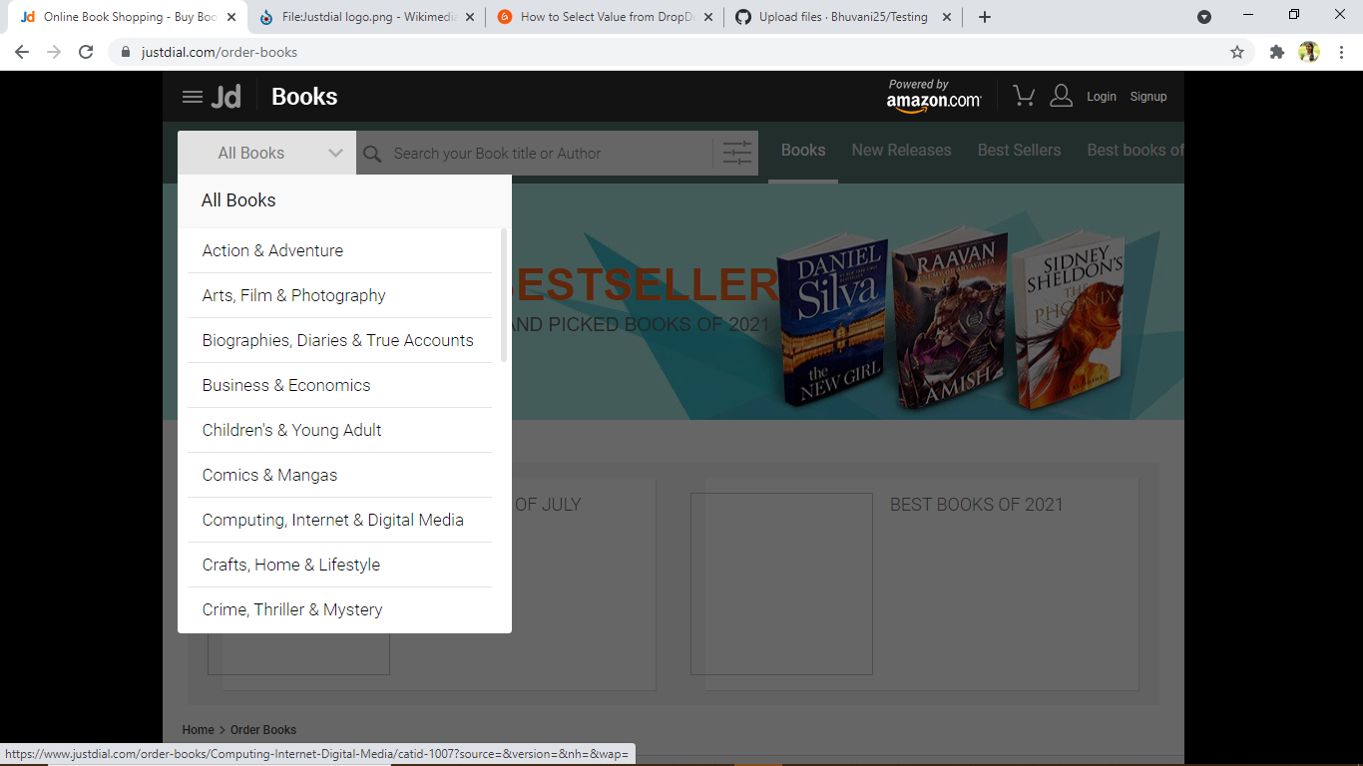
To verify the functionality of Book module from the dropdown
WebElement allbk=driver.findElement(By.xpath("//header/div[2]/div[1]/div[1]/div[1]/div[1]"));
allbk.click();
WebElement drop = driver.findElement(By.id("id_1007"));
drop.click();
System.out.println("Selected Computing, Internet & Digital Media from dropdown menu");
Thread.sleep(2000);

Slide 10
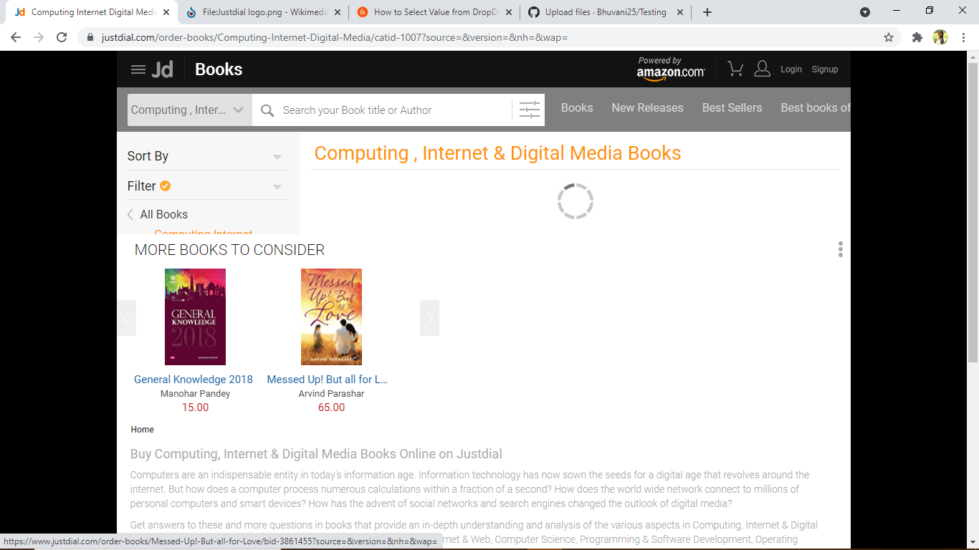
Navigating to Computing, Internet & Digital Media from dropdown menu

Slide 11

To verify the functionality of Navigating back driver.navigate().to(“https://www.justdial.com/”); System.out.println("Navigating back to Justdial");

Slide 12
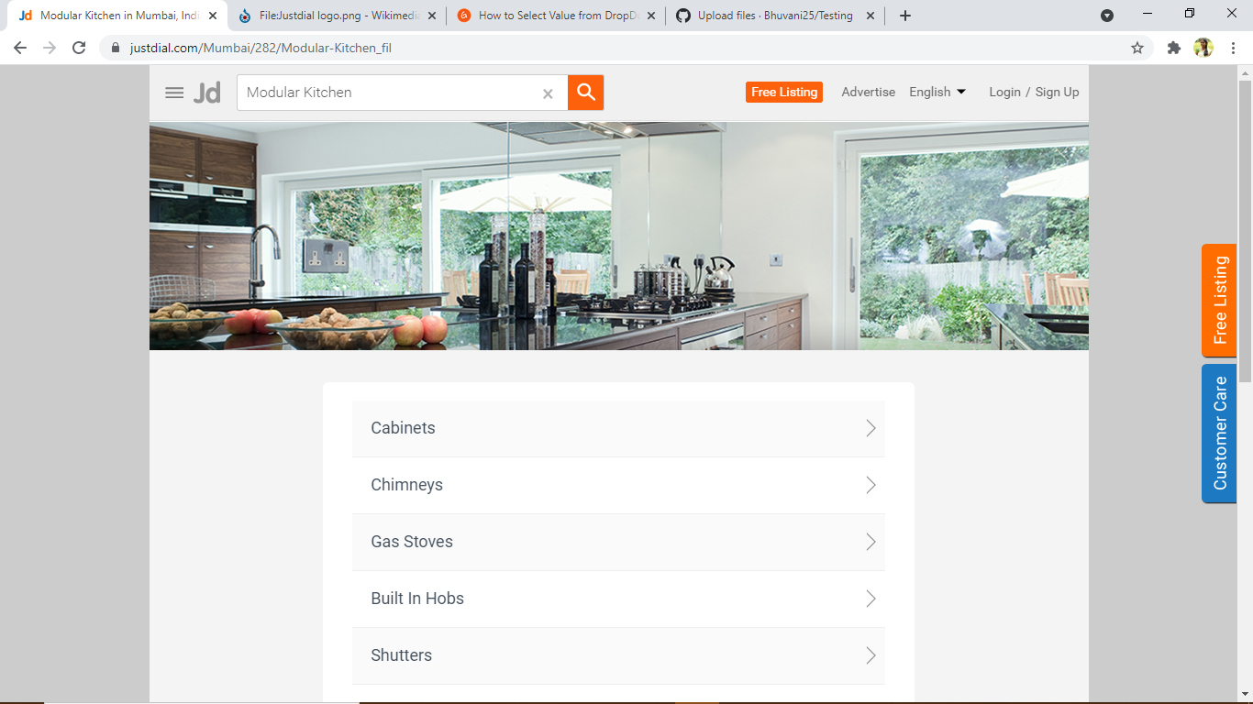
Navigating to second module: Modular Kitchen

Slide 13
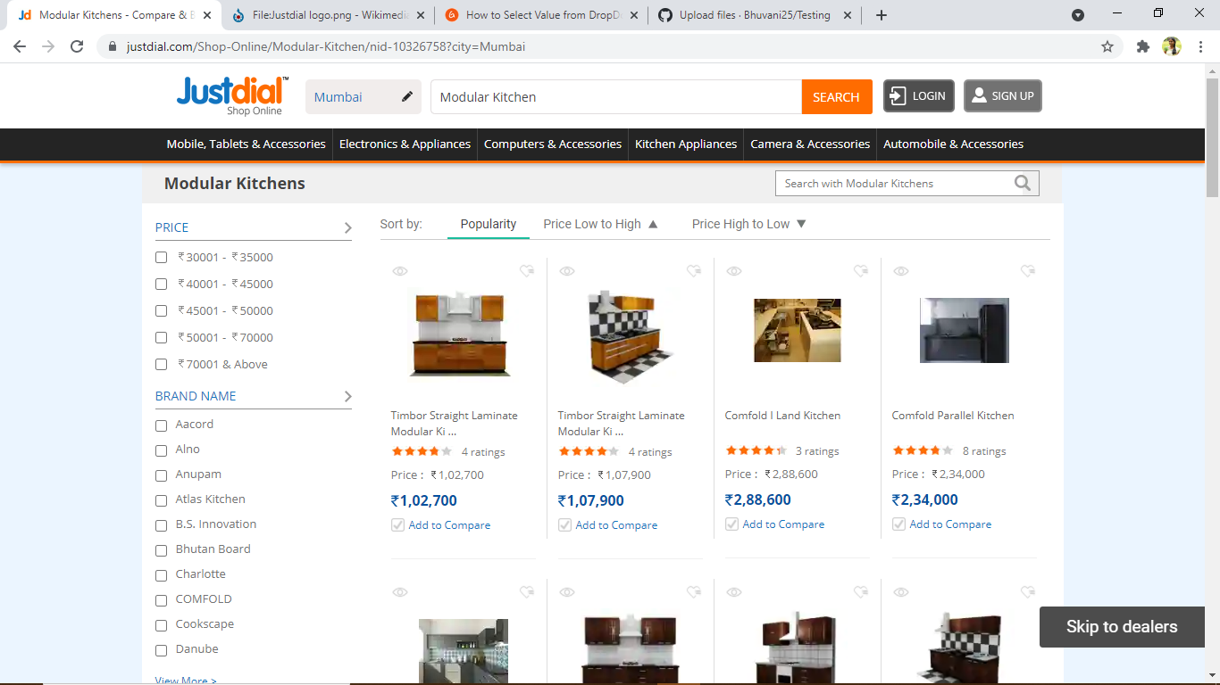
Screenshot of Modular Kitchen module

Slide 14
To verify the checkbox button
WebElement kitchen=driver.findElement(By.id("hotkeys_text_43")); kitchen.click(); System.out.println("Modular Kitchen"); driver.findElement(By.xpath(" //body/div[@id='']/div[2]/div[1]/div[2]/ul[1]/li[8]/a[1]")).click(); System.out.println("Navigating to modular Kitchen Homepage"); Thread.sleep(600); driver.findElement(By.id("103")).click(); driver.findElement(By.id("122")).click(); driver.findElement(By.id("1037")).click(); driver.findElement(By.id("64560")).click(); System.out.println("Selected checkbox for various display option for modular kitchen"); Thread.sleep(2000);

Slide 15
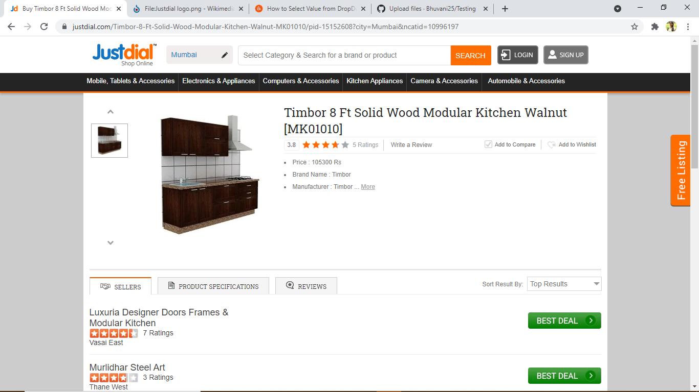
Screenshot of the modular kitchen using checkbox

Slide 16

To verify the functionality of navigating to homepage
driver.navigate().to("https://www.justdial.com/");
System.out.println("Navigating back to homepage of justdial");
Thread.sleep(2000);

Slide 17
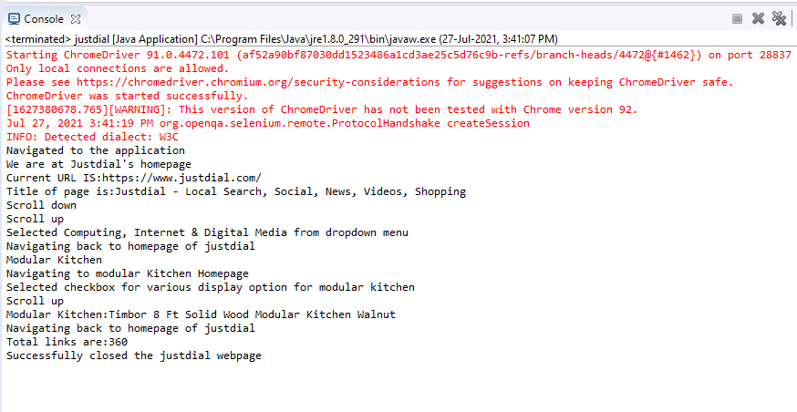
To verify and display the number of links available on page and to close the browser List<WebElement> Links= driver.findElements(By.tagName("a")); int Total_links=Links.size(); System.out.println("Total links are:" + Total_links); driver.close();
Output of the Automation Testing for Justdial website

Slide 18
THANK YOU
By:
Bhuvani Kaveri

